Slide 1

EDA Mini Project
Customer Satisfaction with United Airlines
Group 1 - Data Butcharlo But But
Charles Wong
Hazel Lo

Slide 2

Index
Introduction & Objective
Dataset Overview
Data Preparation
Descriptive Statistics
Analysis - Univariate, Bivariate, Multivariate
Conclusion
Discussion
Reference
Q & A

Slide 3
Introduction & Objective
Client
United Airlines (UA)
Situation
Conducted Satisfaction Survey with Different Categories
Objective
To Improve Customer Satisfaction (find out association & key factors)
Notes:
To investigate the association between different variables and the final satisfaction level
To find out the key factors causing negative experience for the passengers and their ultimate non-positive satisfaction
so that the airline (our client) could make data-driven decisions about which parts of their services they should put into priorities for service improvement

Slide 4
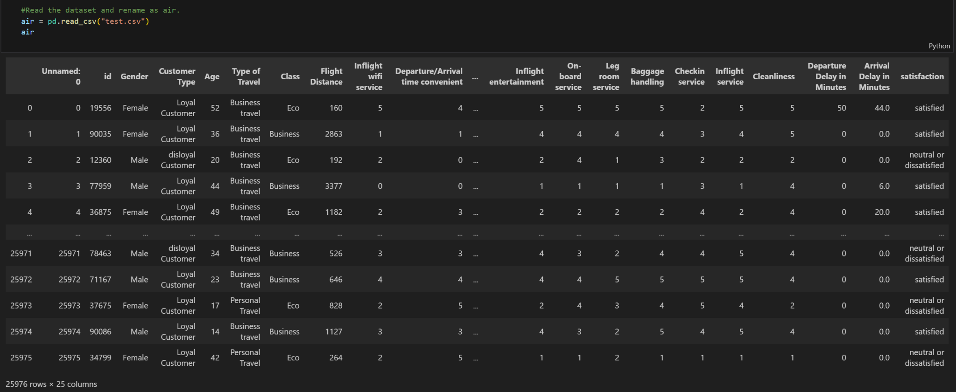
Dataset Overview
Dataset with 25,976 rows x 24 columns (.csv)
Categorical
ID, Gender, Customer Type, Type of Travel, Class, Satisfaction Level, 14-field scoring(5-point likert scale)
Numerical
Age, Flight Distance, Departure and Arrival Delay in Minutes

Slide 5
Dataset Overview
Attribute | Values | Type | Scales of Measurement
Gender | Male, Female | Categorical | Nominal
Customer Type | Loyal, Disloyal | Categorical | Nominal
Age | Actual age of the passenger (in years) | Numerical | Ratio
Type of Travel | Personal, Business | Categorical | Nominal
Class | Business, Economy, Economy Plus | Categorical | Nominal
Flight Distance | Distance of the Flight (nautical miles) | Numerical | Ratio
Delay
Departure Delay in Minutes | Minutes of Delay before Departure | Numerical | Ratio
Arrival Delay in Minutes | Minutes of Delay upon Arrival | Numerical | Ratio

Slide 6
Attribute | Values | Type | Scales of Measurement
Satisfaction Score
Inflight Wifi Service Departure/Arrival Time Convenient Ease of Online Booking Gate Location Food and Drink Online Boarding Seat Comfort Inflight Entertainment On-board Service Leg Room Service Baggage Handling Check-in Service Inflight Service Cleanliness | 0 (not rated), 1, 2, 3, 4, 5 | Categorical | Ordinal
Satisfaction - Airline Satisfaction Level (Binary) | “Satisfaction”, “neutral or dissatisfaction” | Categorical | Nominal
Notes:
Summary
Binary: Gender, Customer Type, Type of Travel
Nominal: Class
Ordinal: Satisfaction ratings for various services
Discrete: Departure and Arrival Delay in Minutes
Continuous: Age, Flight Distance

Slide 7
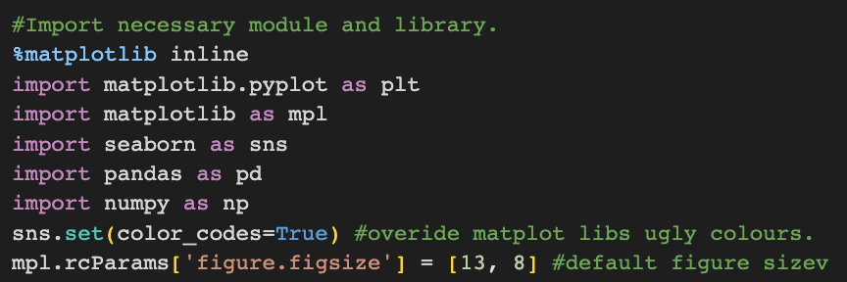
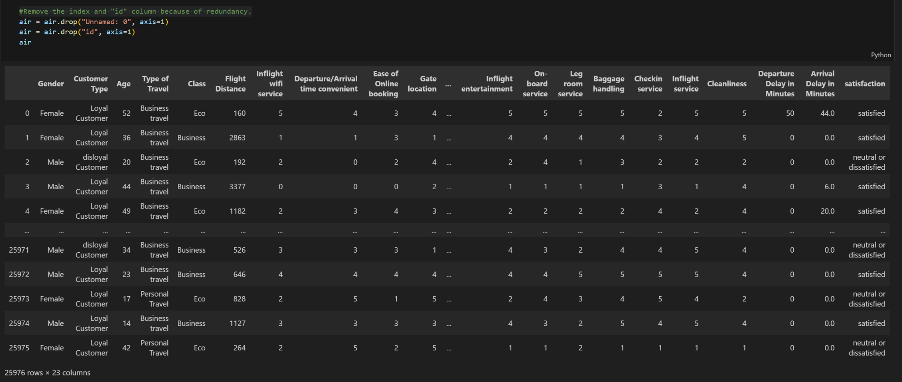
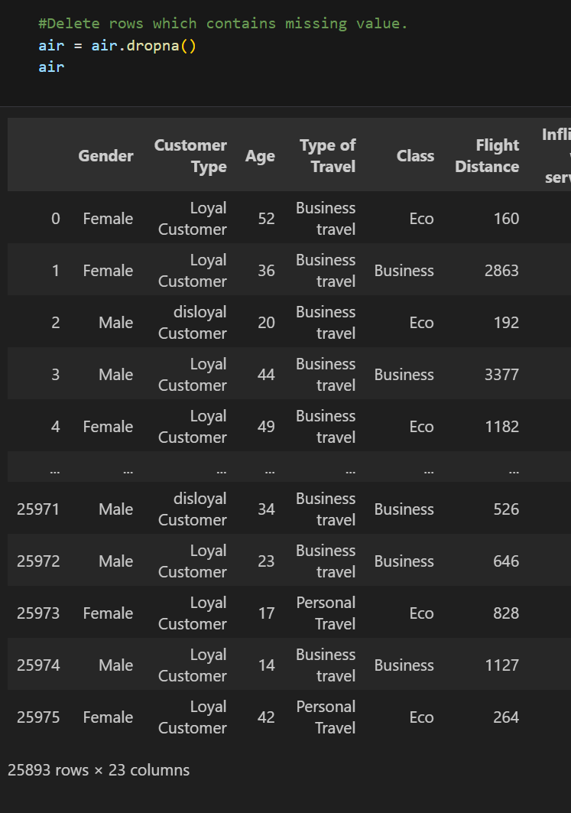
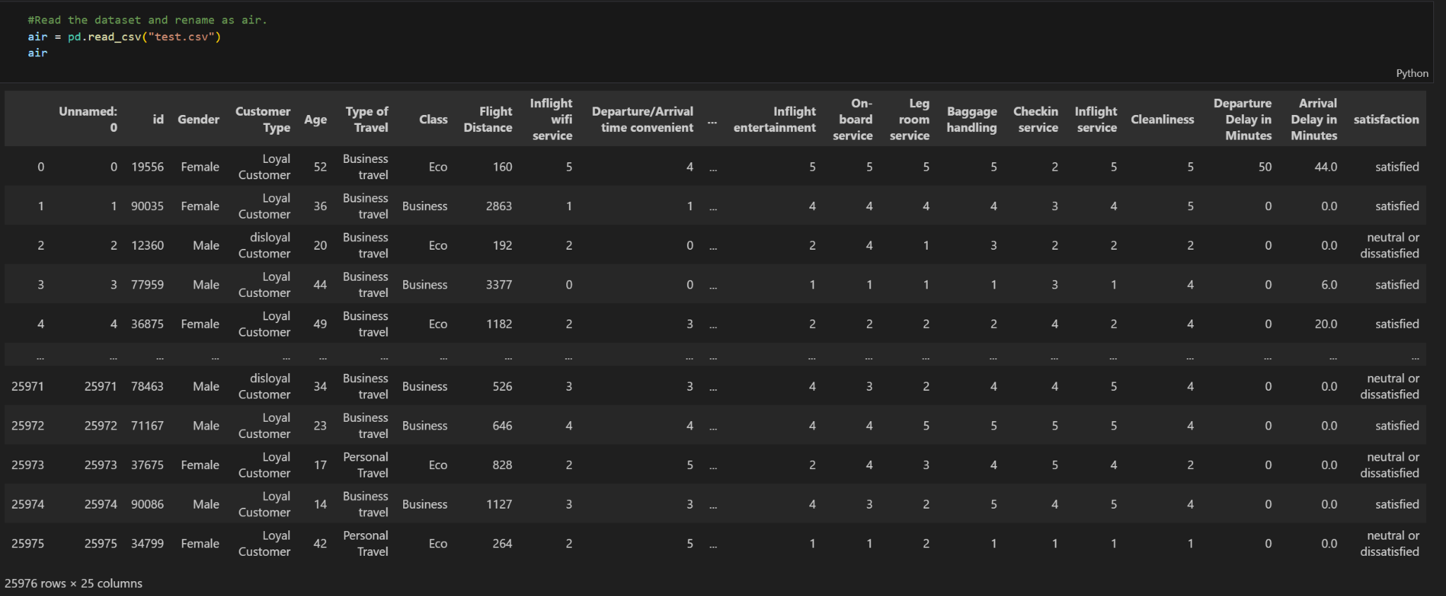
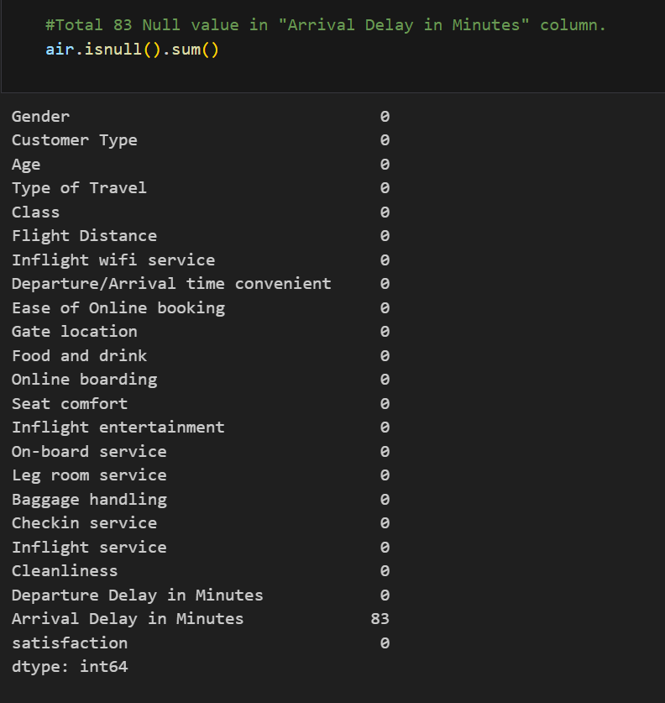
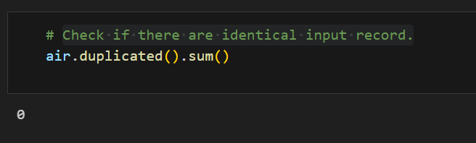
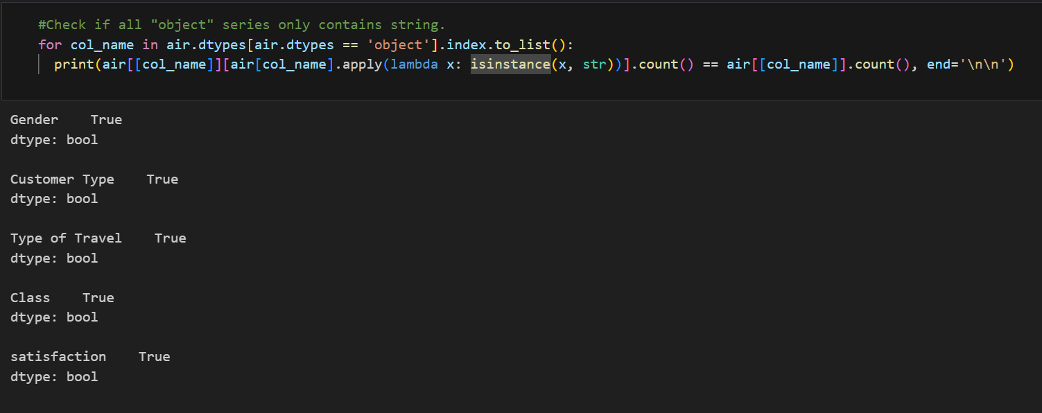

Slide 8
Data Preparation
Import Necessary Modules and Libraries
Read Dataset and Rename as air
Duplicate Input Record Checking
Index and "id" Column Removal (Redundancy)
Null Value Checking and Deletion
Object Series Checking (String)
Unselect Satisfaction Rating with "0" Value (5-point Scale)

Slide 9
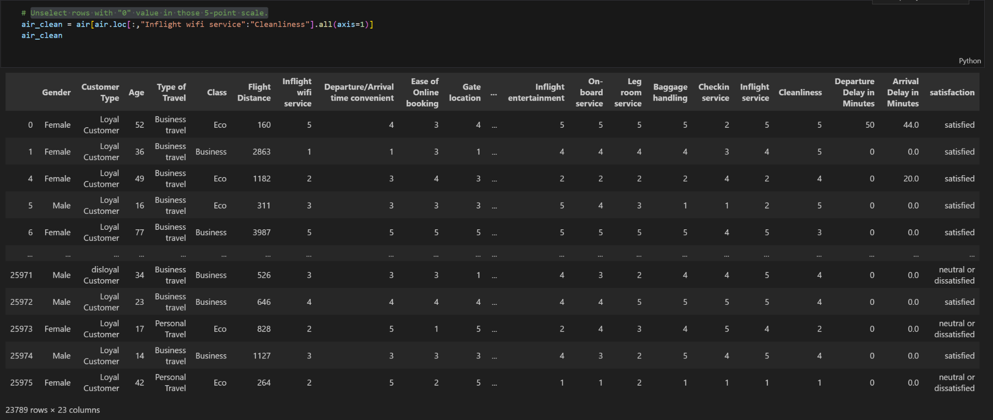
Data Preparation
Remaining 23,789 Valid Record for Following Analysis

Slide 10
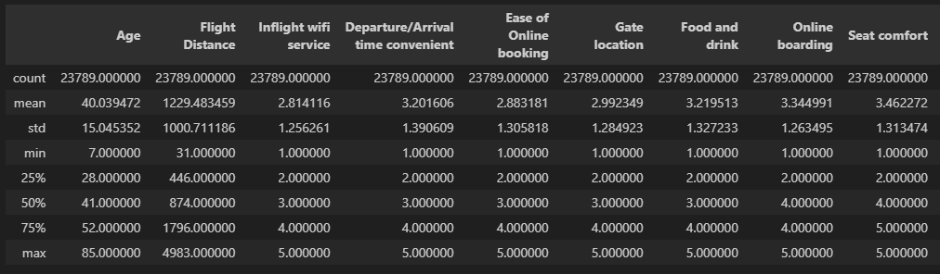
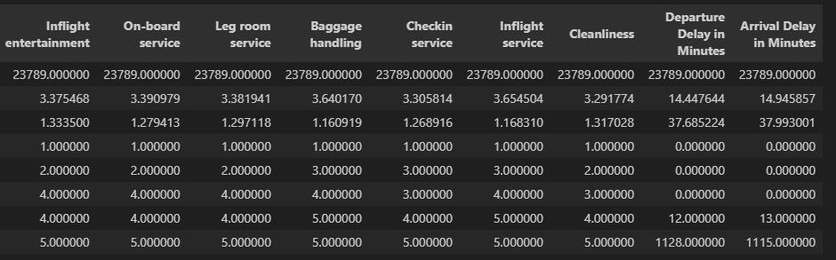
Descriptive Statistics

Slide 11
Analysis - Univariate, Bivariate, Multivariate

Slide 12
Analysis - Univariate

Slide 13
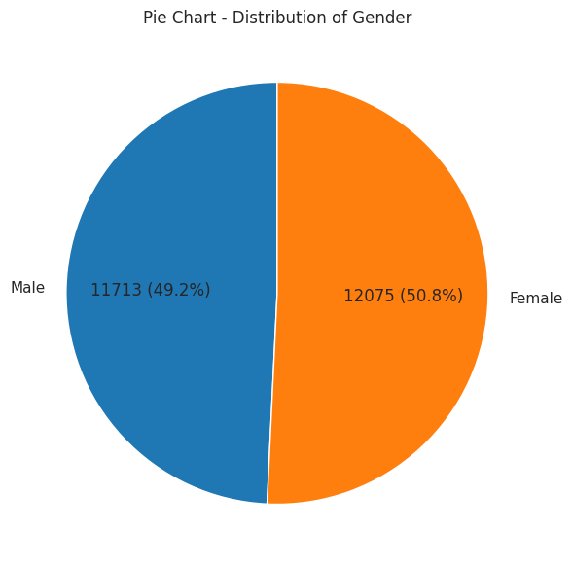
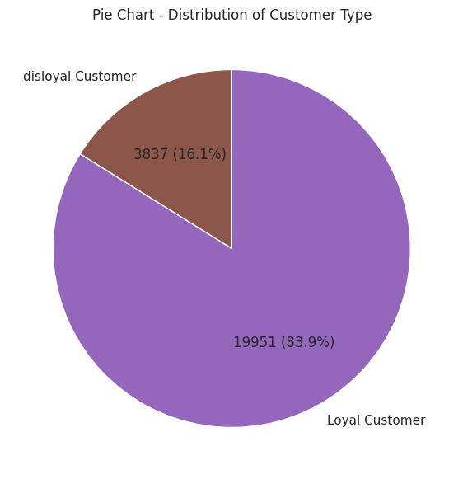
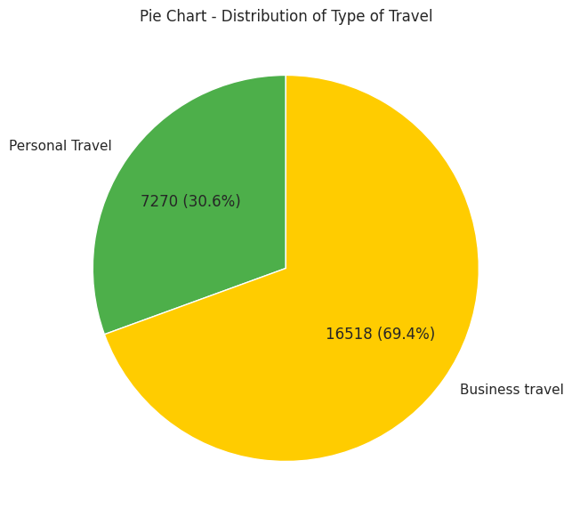
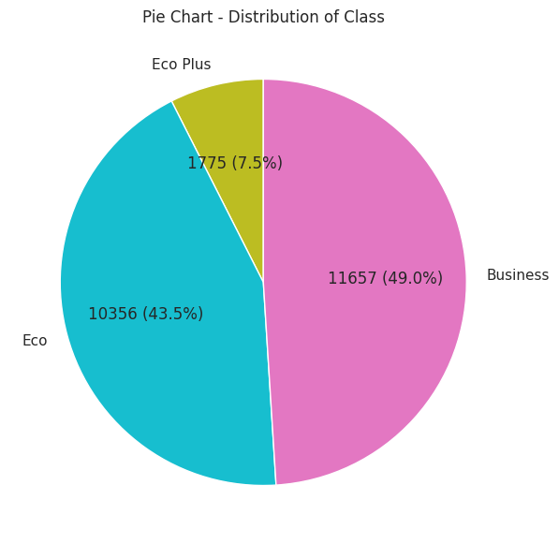
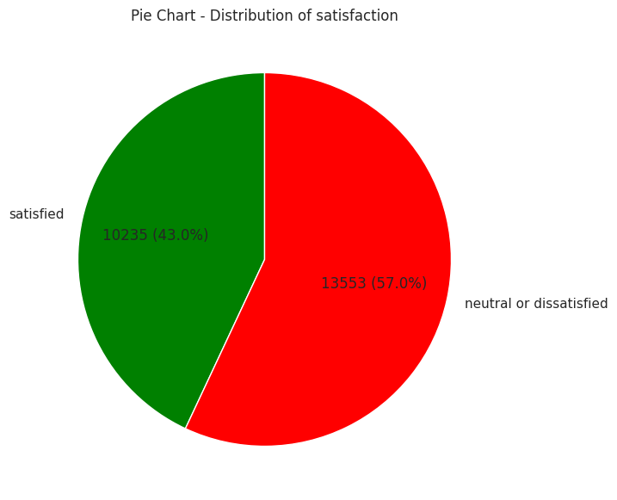
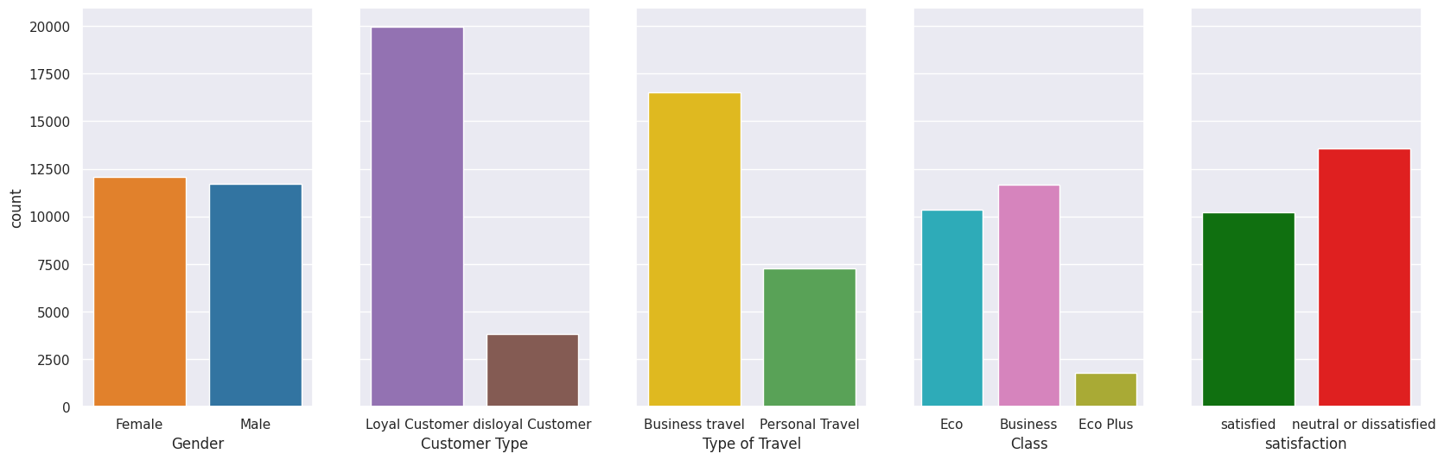
Analysis - Univariate
Univariate - Overall

Slide 14
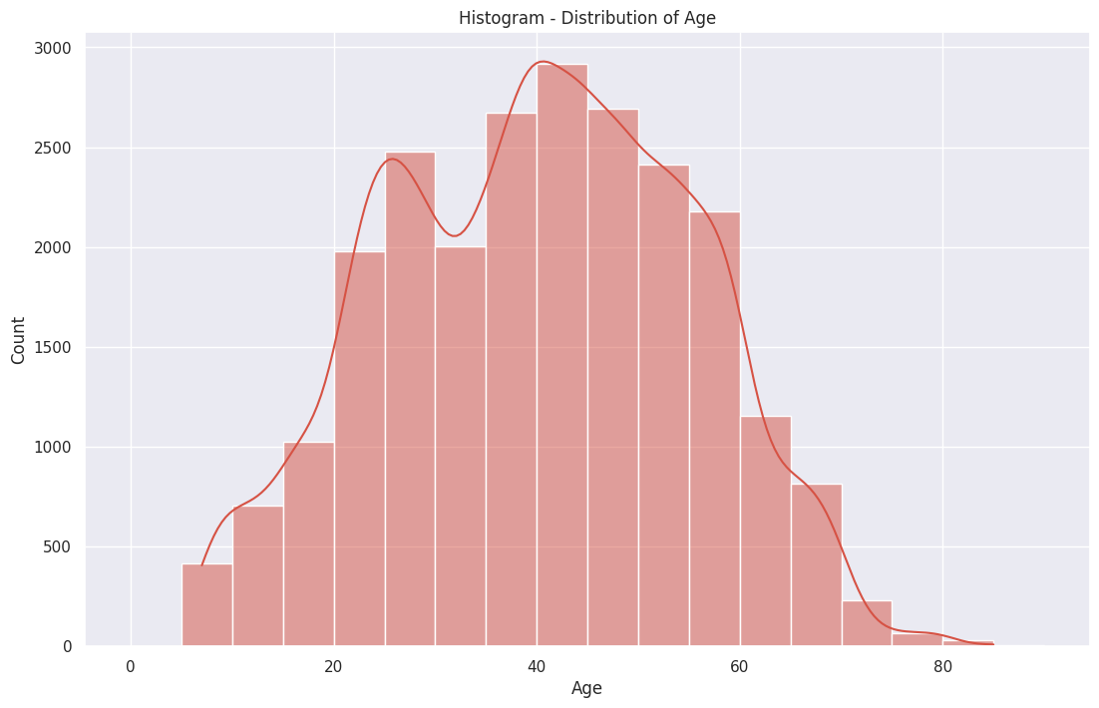
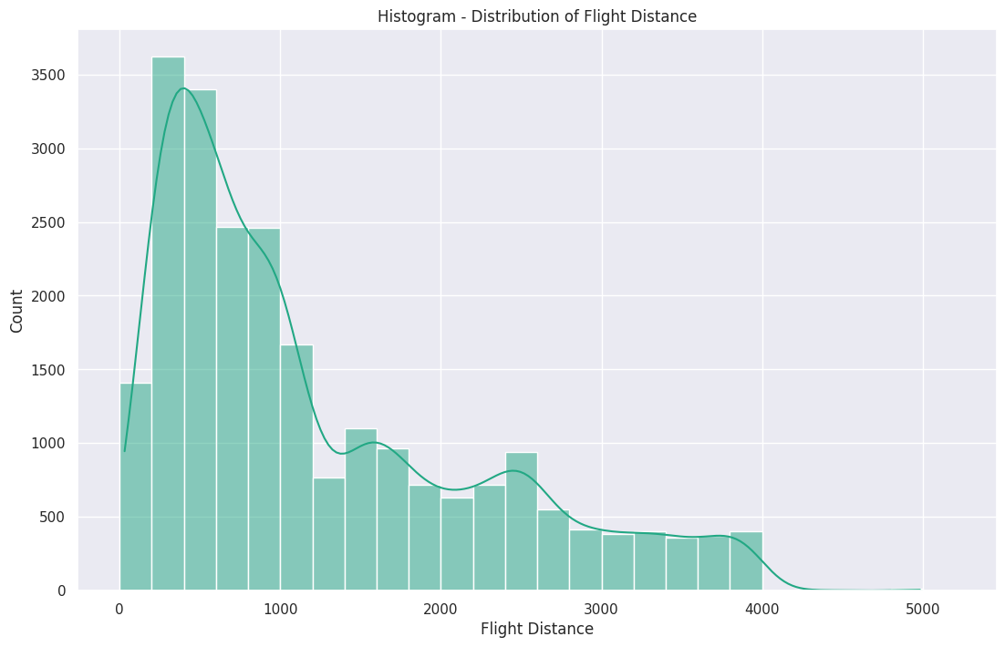
Univariate - Overall
0-600 nmi
600-2600 nmi
Over 2600 nmi

Slide 15
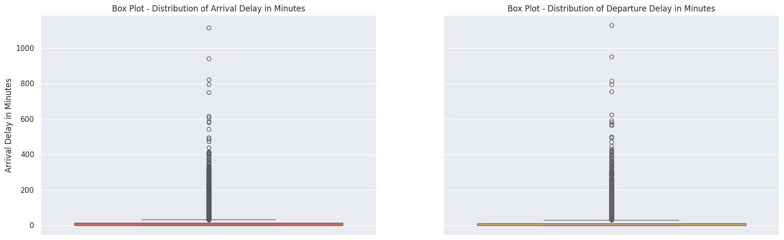
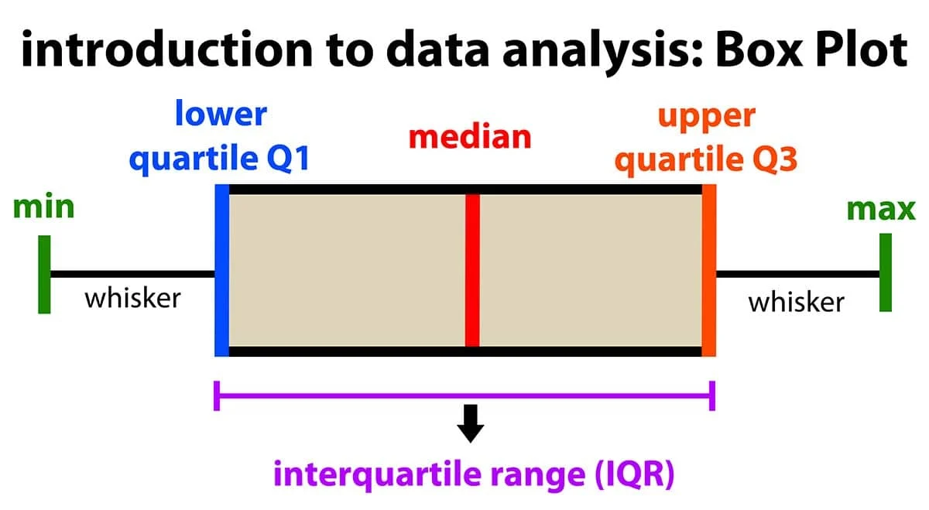
Univariate - Overall
Before zoom-in:
IQRs of both are very close to 0 min
The median delay is low, but extreme outliers suggest some flights face considerable delays.

Slide 16
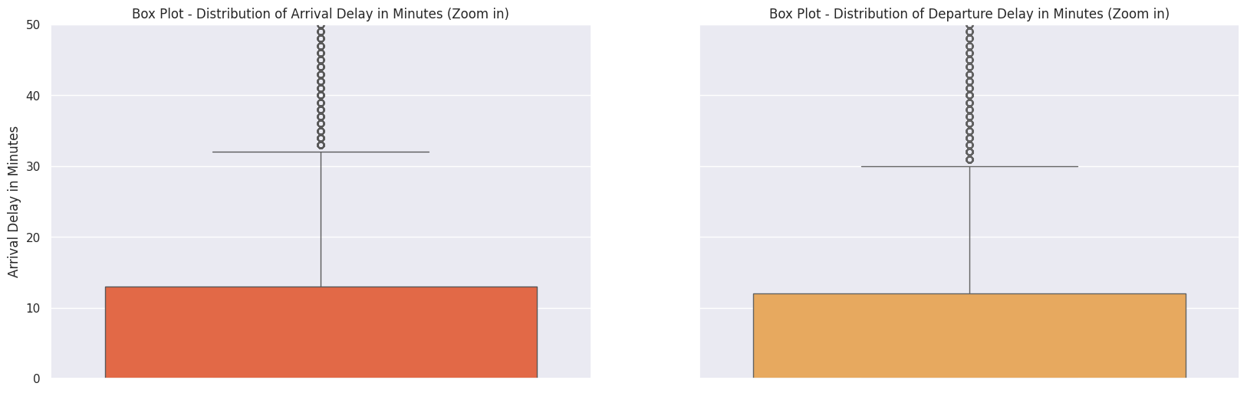
Univariate - Overall
After zoom-in:
IQRs of both fall between 0 - 13 mins

Slide 17
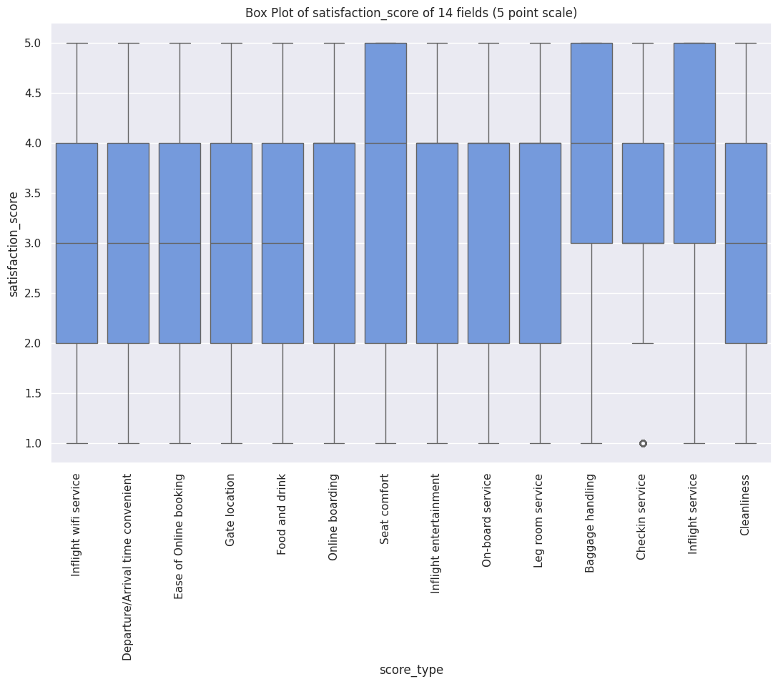
Univariate - Overall

Slide 18
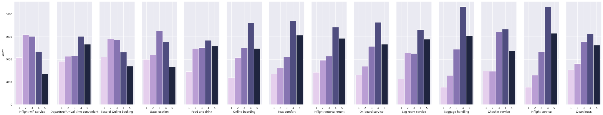
Univariate - Overall
Inflight Wifi Service ⬤
Departure/Arrival Time Convenient
Ease of Online Booking ⬤
Gate Location ⬤
Food and Drink ⬤
Online Boarding
Seat Comfort
Inflight Entertainment
On-board Service
Leg Room Service
Baggage Handling
Check-in Service
Inflight Service
Cleanliness
Notes:
Inflight Wifi Service
Departure/Arrival Time Convenient
Ease of Online Booking
Gate Location
Food and Drink
Online Boarding
Seat Comfort
Inflight Entertainment
On-board Service
Leg Room Service
Baggage Handling
Check-in Service
Inflight Service
Cleanliness

Slide 19
Analysis - Bivariate

Slide 20
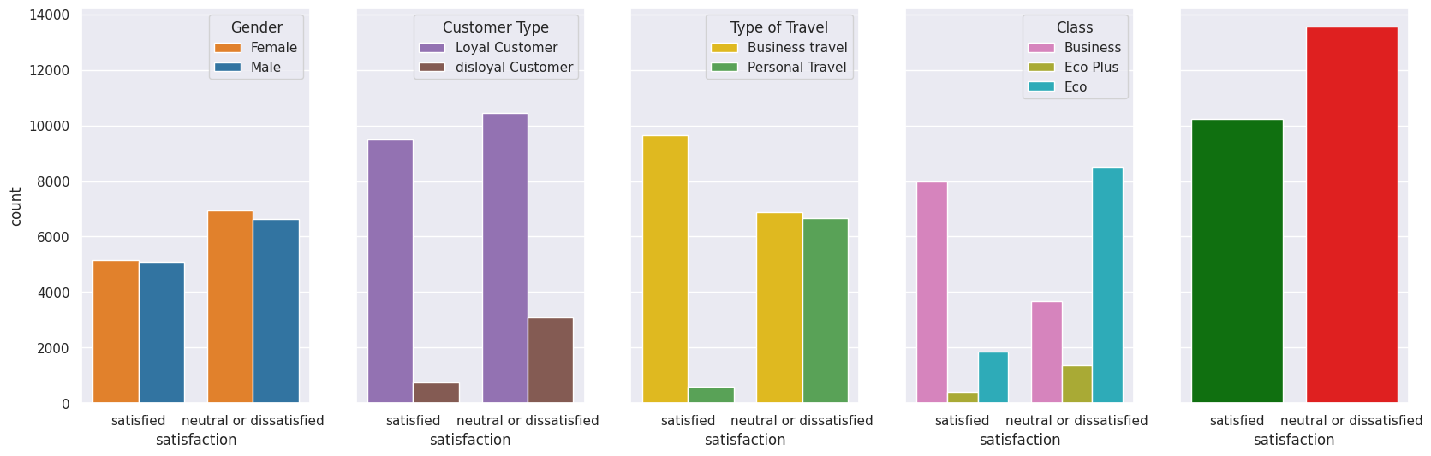
Satisfaction(Binary)
vs
Gender / Customer Type / Type of Travel / Class
Bivariate - Overall

Slide 21
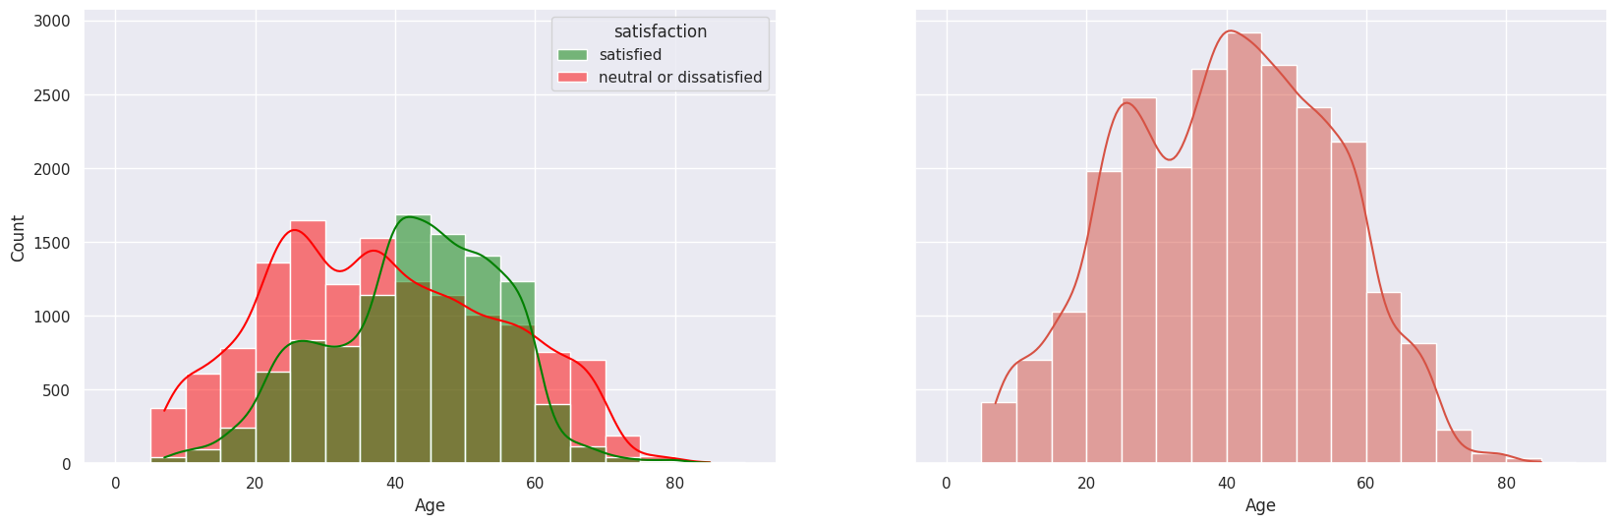
Satisfaction(Binary) vs Age
Bivariate - Overall
Young Adults (Ages 20–40): The majority of neutral or dissatisfied individuals fall within this age range.
Middle-Aged Adults (Ages 40–60): Satisfaction levels peak in this age group, with the highest count of satisfied individuals. Neutral or dissatisfied counts decrease compared to younger age groups.
Older Adults (Ages 60+): Satisfaction levels drop significantly, with fewer individuals reporting satisfaction. Neutral or dissatisfied counts also decline, likely due to a smaller sample size in this age group.
Notes:
Key Observations:
Young Adults (Ages 20–40): The majority of neutral or dissatisfied individuals fall within this age range.
Middle-Aged Adults (Ages 40–60): Satisfaction levels peak in this age group, with the highest count of satisfied individuals. Neutral or dissatisfied counts decrease compared to younger age groups.
Older Adults (Ages 60+): Satisfaction levels drop significantly, with fewer individuals reporting satisfaction. Neutral or dissatisfied counts also decline, likely due to a smaller sample size in this age group.

Slide 22
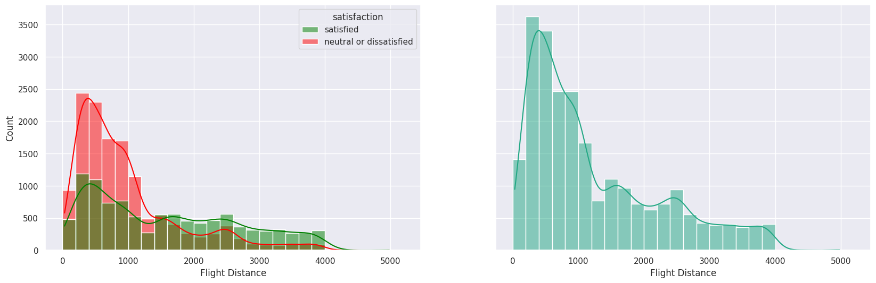
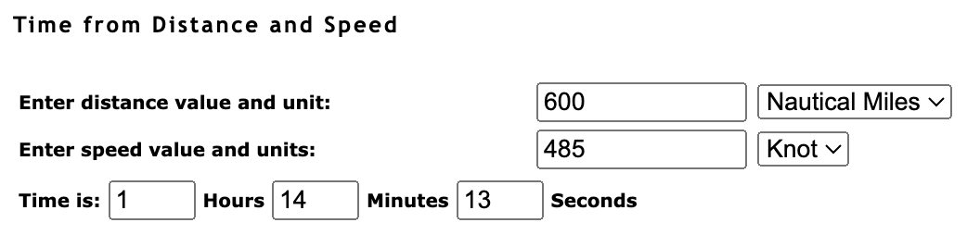
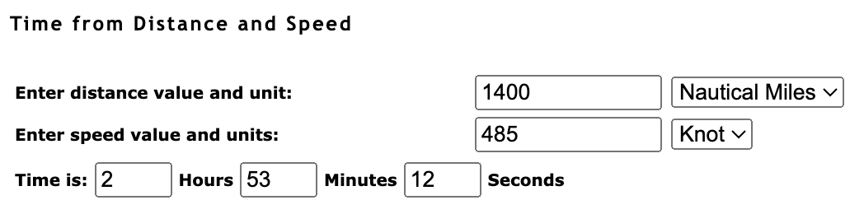
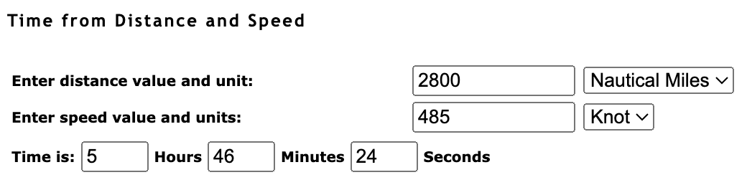
Satisfaction(Binary) vs Flight Distance
Bivariate - Overall
Overall: More short-haul to medium-short-haul flights (esp. under 1200 nmi)
Short-haul to Medium-short-haul: Red bar > Green bar = dissatisfied proportion is larger
Medium-long-haul (1601-2600) & Long-haul (2601-4000): Green bar > Red bar = satisfied proportion is larger
Notes:
Average speed of a commercial plane: roughly 450 to 520 knots (=~485knots)
12 mins 22 s for every 100 nmi
short(1-600) : 600 nmi = 1 hr 14 mins
Medium-short(601-1600): 1400 nmi = 2 hr 53 mins ; 1600 equal equal
Medium-long(1601-2600): green bar > red bar = satisfied proportion is larger
Long(2601-4000): green bar > red bar = satisfied proportion is larger

Slide 23
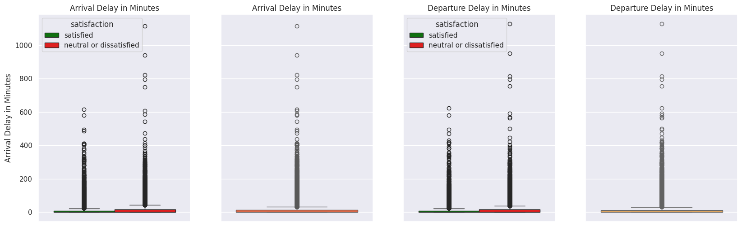
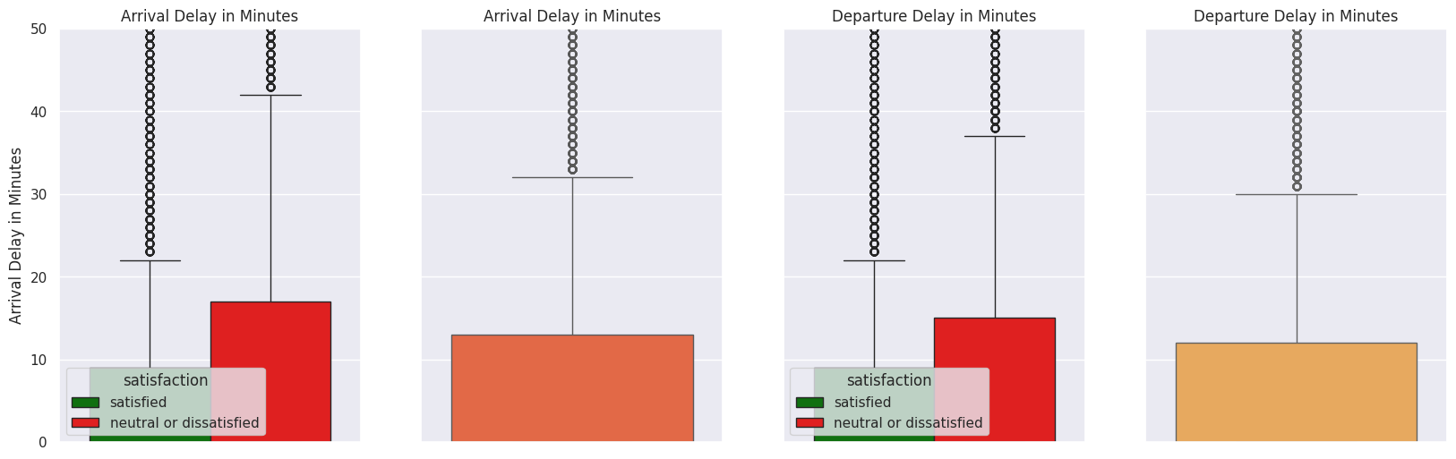
Satisfaction(Binary) vs Delay
Bivariate - Overall
Overall:
Zoom-in:
Arrival Delay
Departure Delay

Slide 24
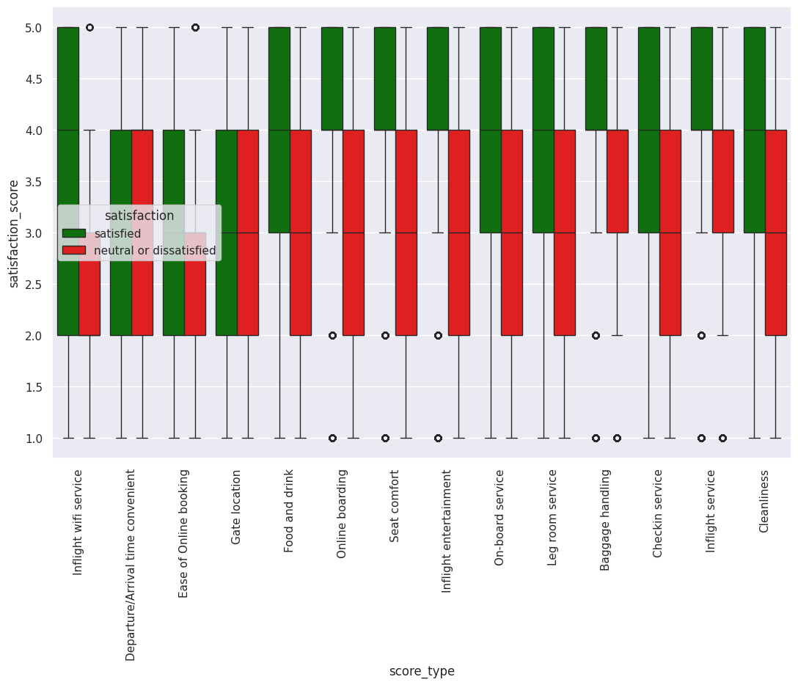
Satisfaction(Binary)
vs Satisfaction Score
Bivariate - Overall

Slide 25
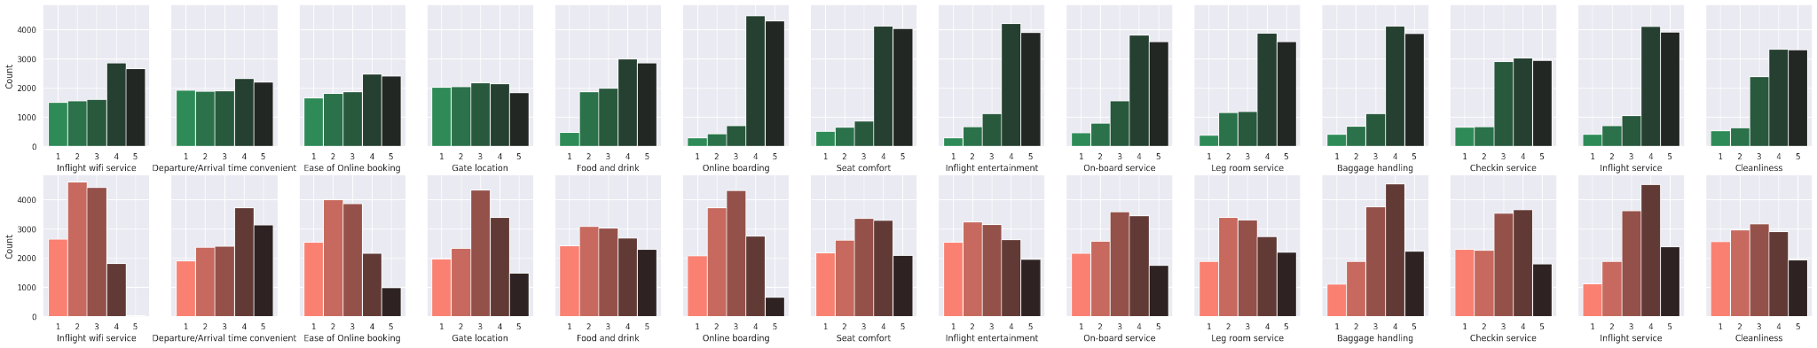
Satisfaction(Binary)
vs
Satisfaction Score(rating)
Bivariate - Overall
Inflight Wifi Service ⬤ ⬤
Departure/Arrival Time Convenient
Ease of Online Booking ⬤ ⬤
Gate Location ⬤
Food and Drink ⬤
Online Boarding ⬤
Seat Comfort
Inflight Entertainment
On-board Service
Leg Room Service
Baggage Handling
Check-in Service
Inflight Service
Cleanliness

Slide 26
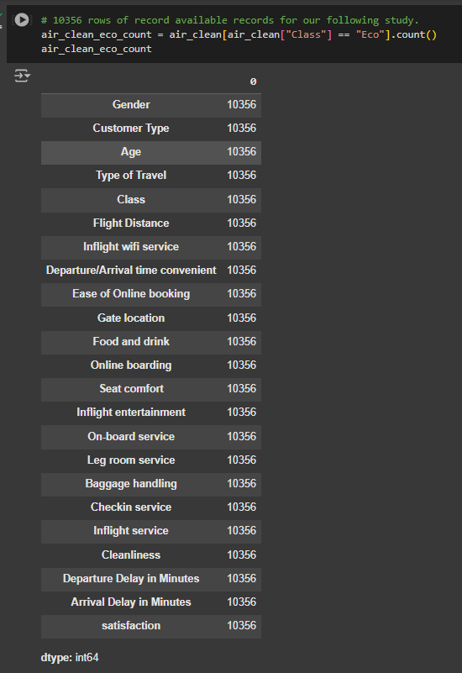
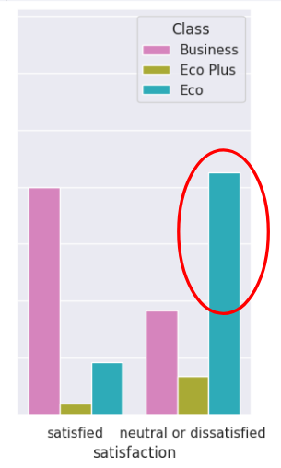
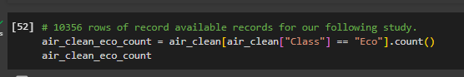
Select Group Study - Eco(Economy) Focus
Eco class has most dissatisfied customers
We wanna figure out which few factors matter the most to their dissatisfaction
Thus, we select Eco Class to study hereafter. Let’s go!
Further data processing - Eco Class, 10356 rows of record
Notes:
after we talk about our findings on Final Satisfaction vs Class --- Eco class has most dissatisfied customers, and, we wanna figure out which few factors matter the most to their dissatisfaction (or also satisfaction maybe? so we can know more about what makes them happy)! Thus, we select Eco Class to study hereafter

Slide 27
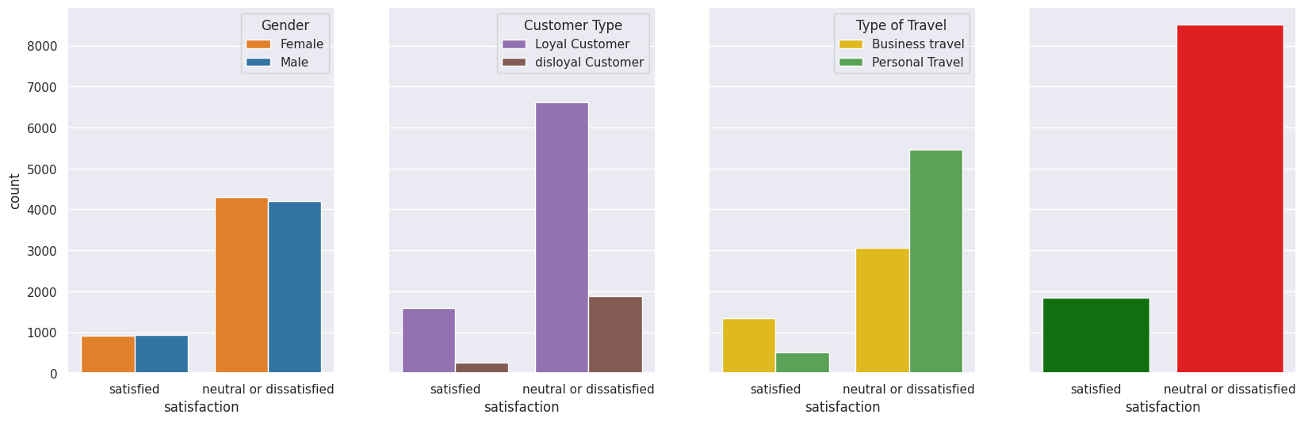
Satisfaction(Binary)
vs
Gender / Customer Type
/ Type of Travel / Class
Bivariate - Econ Focus

Slide 28
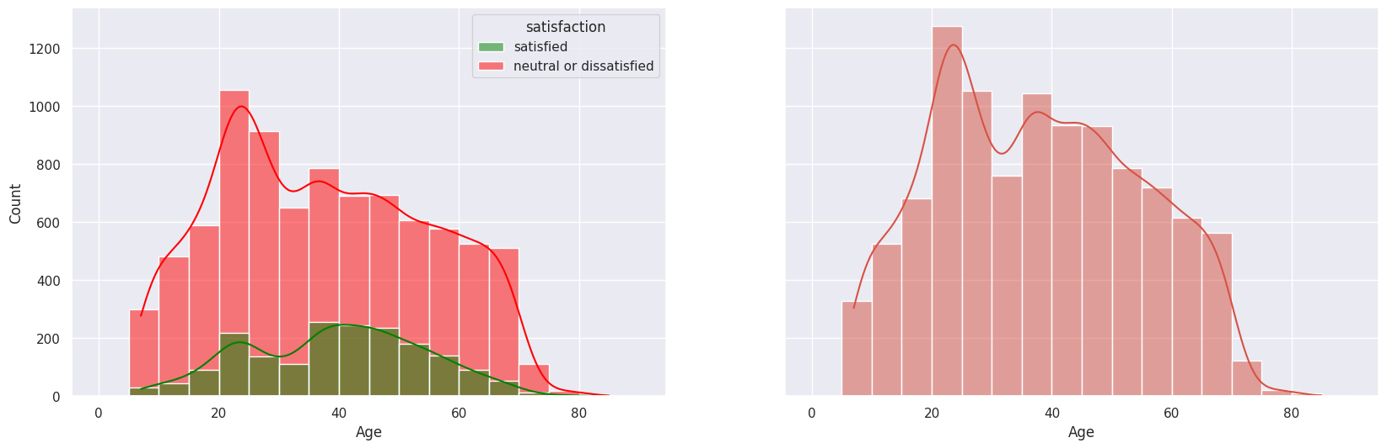
Satisfaction(Binary)
vs
Age
Bivariate - Econ Focus

Slide 29
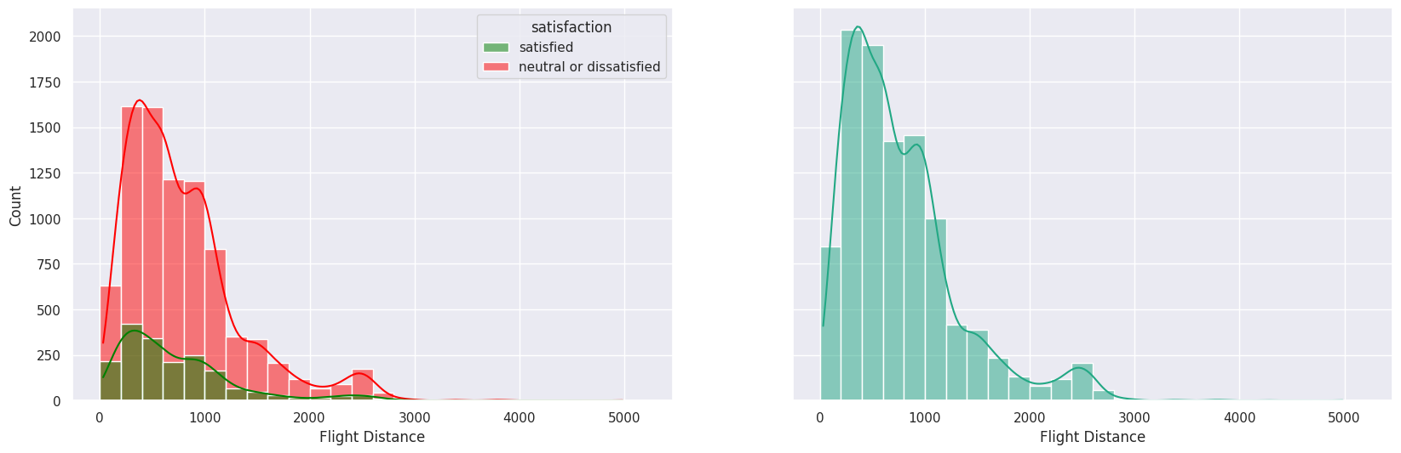
Satisfaction(Binary)
vs
Flight Distance
Bivariate - Econ Focus

Slide 30
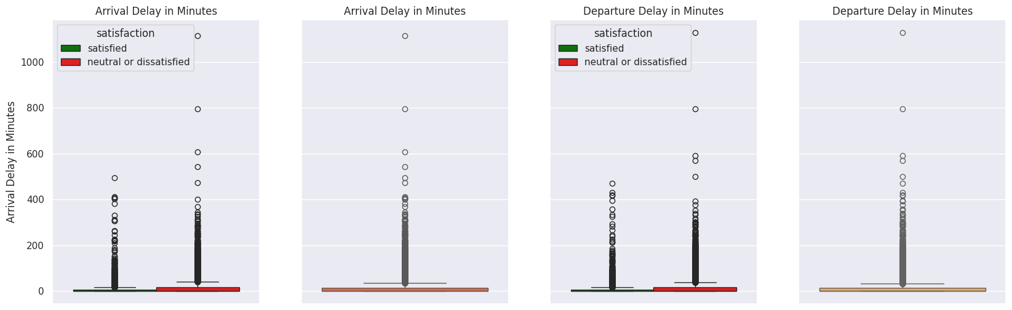
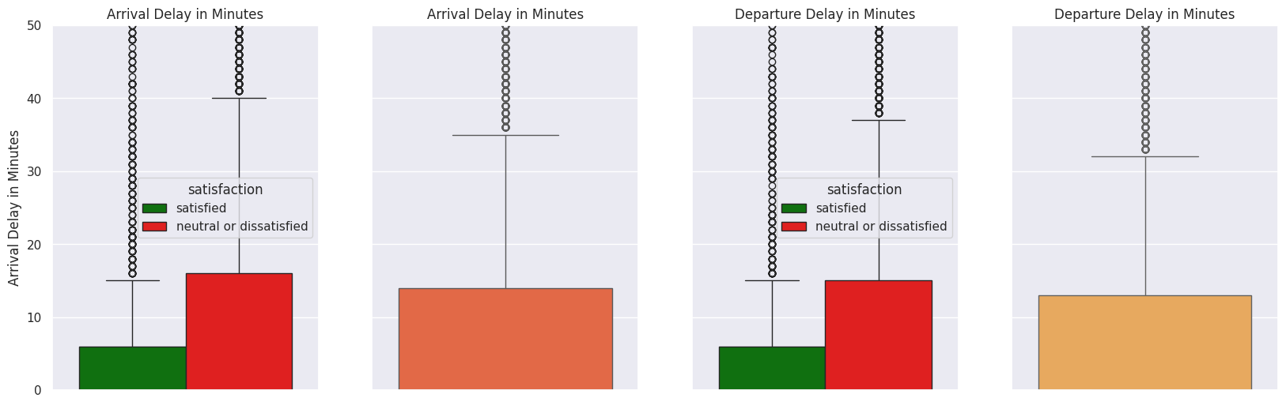
Satisfaction(Binary)
vs
Delay
Bivariate - Econ Focus

Slide 31
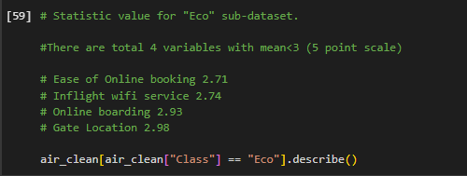
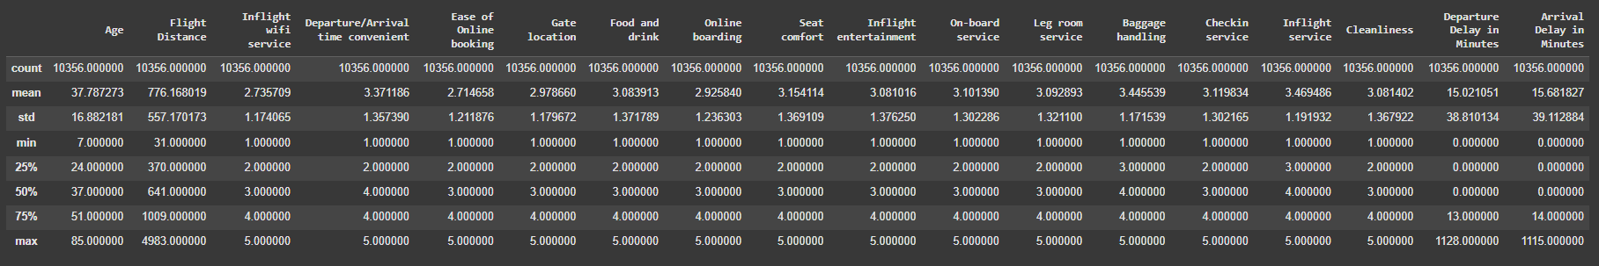
Bivariate - Econ Focus

Slide 32
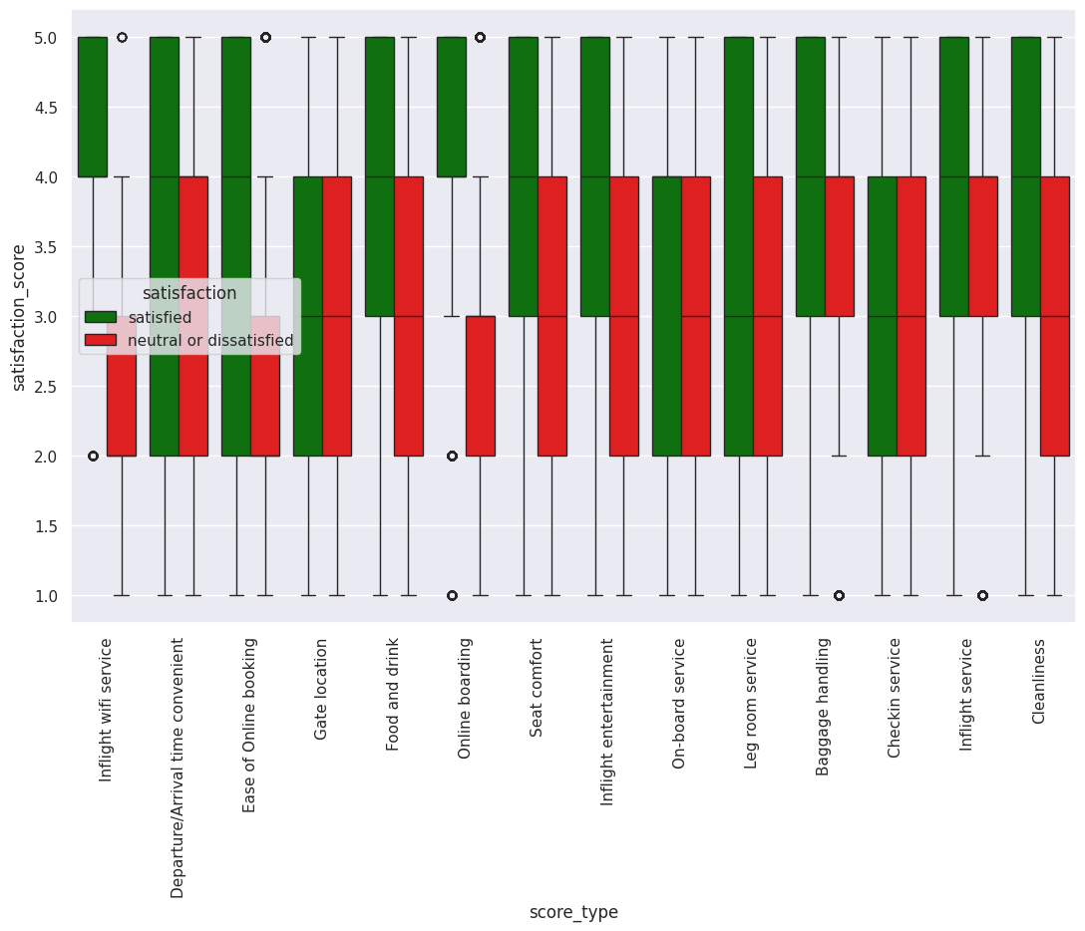
Bivariate - Econ Focus
Econ Class
Overall
Notes:
Strongest Performing Areas:
These categories show higher satisfaction scores among satisfied customers (green bars)
Areas Needing Improvement:
These categories show lower satisfaction scores even among satisfied customers, and notably low scores among neutral/dissatisfied customers
Satisfaction Gap:
a consistent gap between satisfied and neutral/dissatisfied customers across all service categories
Score Distribution:
Most satisfied customers (green boxes) show relatively compact IQRs in the 4.0-5.0 range
Neutral/dissatisfied customers (red boxes) show wider IQRs, typically between 2.0-4.0
Variability Analysis:
Highest variability: "Inflight WiFi service" shows the largest spread in both satisfaction groups
Most consistent: "Inflight staff service" and "Cleanliness" show more compact boxes, indicating more consistent ratings
Outliers:
Several outliers are visible (dots), particularly in services like:
Departure/Arrival time convenience
Online boarding
Gate location
Median Differences:
Largest median gaps between satisfied and dissatisfied customers appear in:
Inflight WiFi service
Food and drink
Seat comfort

Slide 33
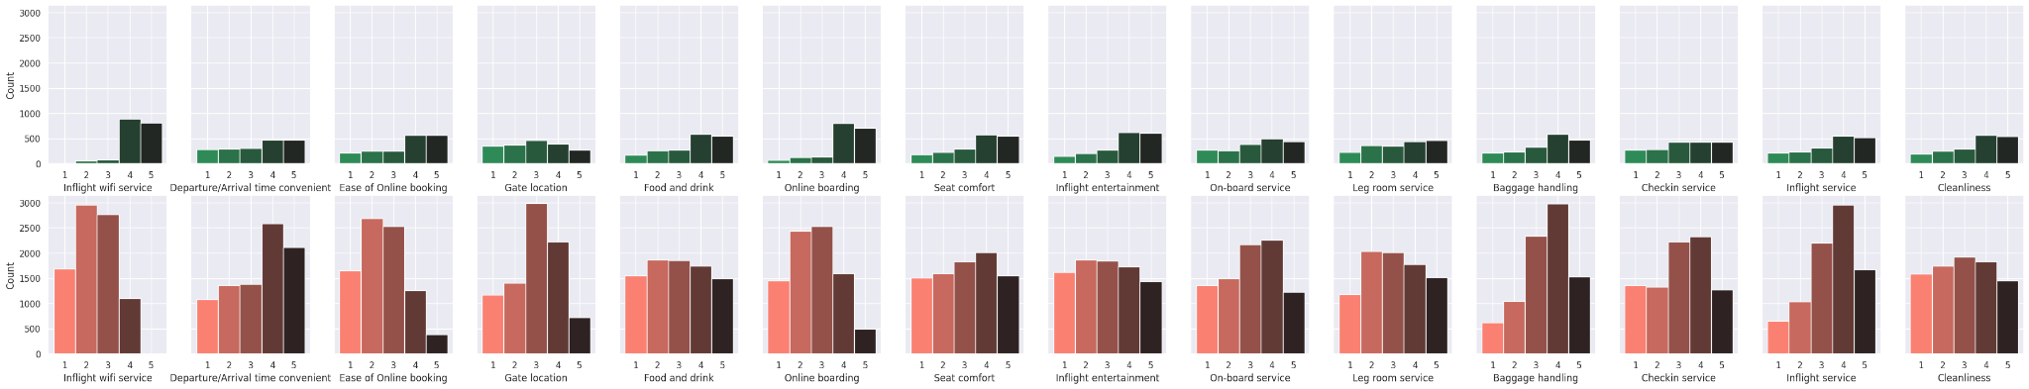
Bivariate - Econ Focus
Inflight Wifi Service ⬤ ⬤ ⬤
Departure/Arrival Time Convenient
Ease of Online Booking ⬤ ⬤ ⬤
Gate Location ⬤
Food and Drink ⬤
Online Boarding ⬤ ⬤
Seat Comfort
Inflight Entertainment
On-board Service
Leg Room Service
Baggage Handling
Check-in Service
Inflight Service
Cleanliness
Overall
Econ Class

Slide 34
Analysis - Multivariate

Slide 35
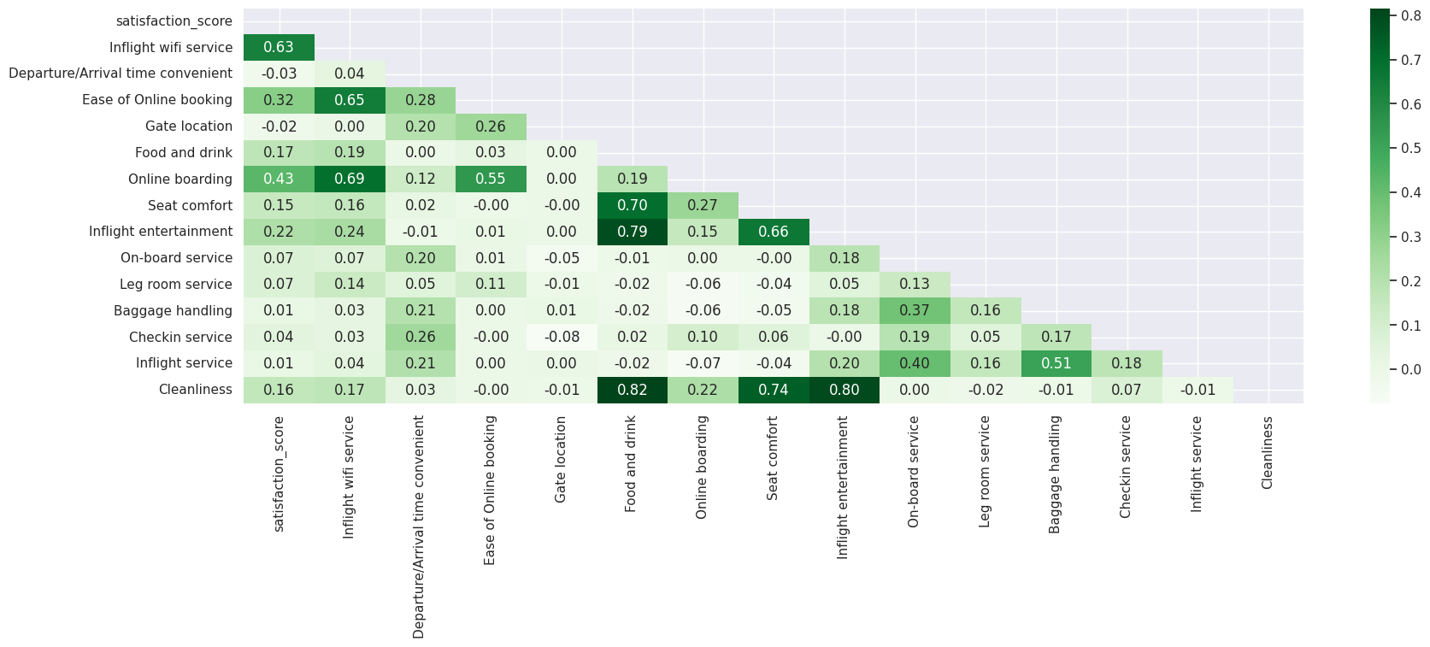
Multivariate- Econ Focus
Econ Class

Slide 36
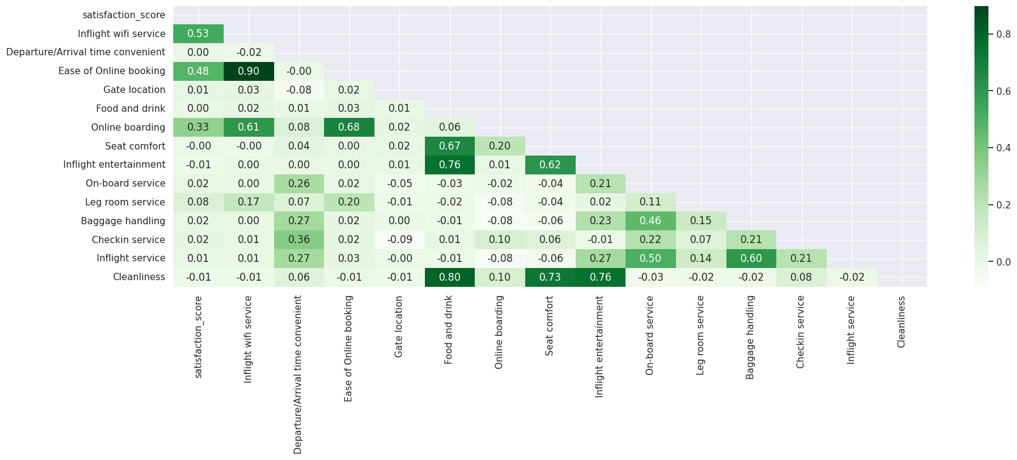
Multivariate- Econ Focus
Econ Class
Personal Travel

Slide 37
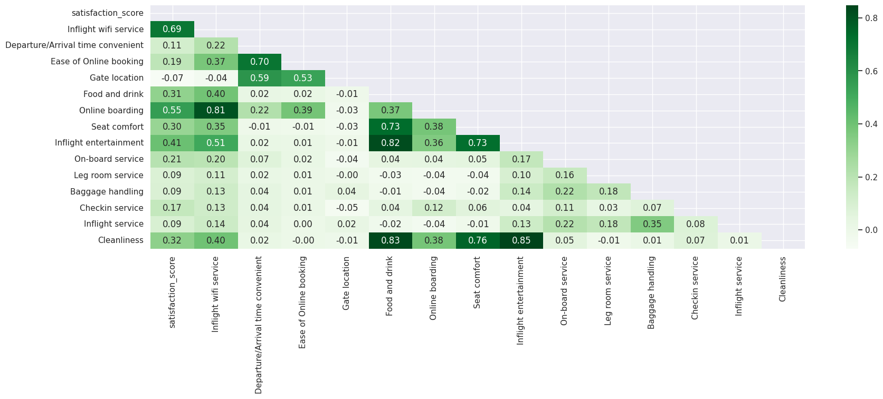
Multivariate- Econ Focus
Econ Class
Business Travel

Slide 38
Conclusion
In Order to Improve Satisfaction Level, UA Can Focus on:
For Both Eco- Business/Personal Travellers:
1. Inflight wifi service
3. Ease of Online booking
6. Online boarding
For Eco- Business Travellers(Not just above mentioned but also):
5. "Food and Drink"
7. "Seat Comfort"
8. "Inflight entertainment"
14. "Cleanliness"
Inflight Wifi Service ⬤ ⬤ ⬤
Departure/Arrival Time Convenient
Ease of Online Booking ⬤ ⬤ ⬤
Gate Location ⬤
Food and Drink ⬤
Online Boarding ⬤ ⬤
Seat Comfort
Inflight Entertainment
On-board Service
Leg Room Service
Baggage Handling
Check-in Service
Inflight Service
Cleanliness

Slide 39
Discussion
Challenges
Large Scale Dataset
Analysis Direction
Time Constraint
Graph Generation
Limitation
Lack of Crucial Data (Price)
Unsensitive Satisfaction Level Data (Satisfied vs Neutral or Dissatisfied)
Unsensitive Interval Data(5-point Scale)
Future Improvement
Set-up Working Schedule, Adjust Scope if Applicable
Determine Focus Area Before Conducting Analysis

Slide 40
Future Work
Relationship Between Flight Distance/Age and Satisfaction Level/ Other Particular Measurement item
Time Constraint
Complexity
Precise Analysis Result
Area That UA Need Improvement The Most (Resource constraint)
Logistic Regression(ML)

Slide 41
Reference
Data Source:
Airline Passenger Satisfaction, https://www.kaggle.com/datasets/teejmahal20/airline-passenger-satisfaction

Slide 42

Q & A

Slide 43
End of Presentation

